Slide 1
PHLOX E-Commerce
Team No:10
Submitted By:
LivArpit Sandhu (2210990543)
Aashvi Chawla (2210990019)
Kshitij Raj Shukla (2210990526)
Lokesh Vaid (2210990545)
Submitted To : Baljit Kaur
Vikas Patel

Slide 2
Index
Objective
Introduction
Key Features
Technical details
Snapshots
Conclusion
Reference

Slide 3

Objective

Slide 4
“ The objective of creating an e-commerce site using HTML, CSS, and JavaScript is to develop a functional and visually appealing online platform for buying goods or services over the internet.”
Here are some specific objectives :
User-Friendly Interface: Design the website with a clean and intuitive layout to make it easy for users to navigate and find products they are interested in purchasing.
Product Listings: Implement a system for displaying products with relevant details such as images, descriptions, prices, and availability.
Shopping Cart: Develop a shopping cart functionality that allows users to add/remove items, view their cart contents, and proceed to checkout.

Slide 5
Search and Filter: Provide search and filtering options to help users easily find products based on their preferences, categories, price range, etc.
Product Reviews and Ratings: Allow users to leave reviews and ratings for products, contributing to trust and transparency in the buying process.
Order Management: Implement functionality for managing orders, including order tracking, status updates, and communication with customers regarding their purchases.
By achieving these objectives, the e-commerce site can effectively facilitate online transactions, enhance customer satisfaction, and contribute to the success of the business.

Slide 6
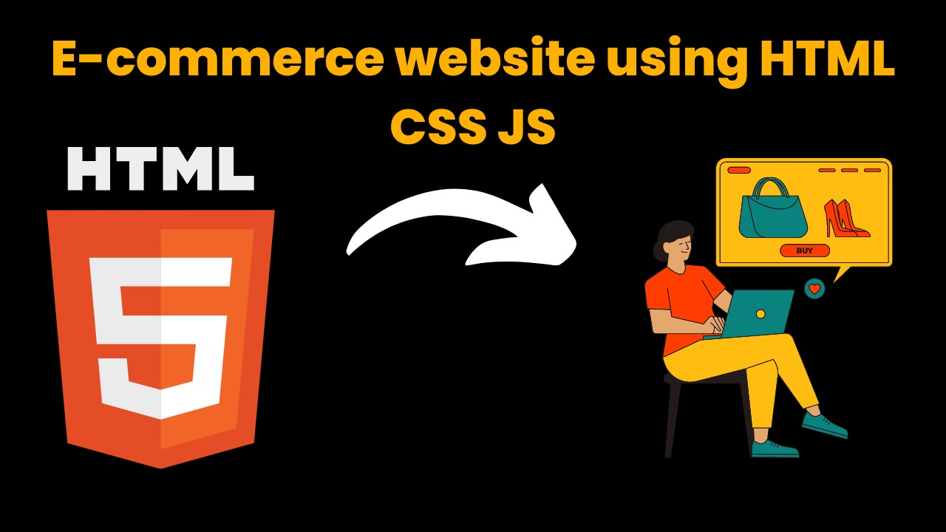
Introduction
The Online E-commerce Web Application Services department aims to streamline digital processes, reducing time and human effort. Services include digitizing analog objects , managing metadata, preserving digital content, and facilitating access to digital collections. The Shop Management System, accessible across operating systems, simplifies shop organization virtually. Its user-friendly interface caters to users of all levels, boasting robust search, insertion, and reporting features. The system's report generation capability offers insights into member purchases, enhancing product accessibility.
The PHLOX website endeavors to simplify shopping experiences in the digital age, alleviating time constraints and simplifying tasks. It supports shop collections, digital initiatives, and partner institution projects by digitizing analog items, managing metadata, preserving digital content, and enabling access to digital collections. This user-friendly web application, compatible with all operating systems, facilitates virtual shop organization and management. Its intuitive interface, coupled with advanced search, insertion, and reporting functions, ensures accessibility and efficiency for users of all skill levels. With comprehensive reporting capabilities, users gain valuable insights into member purchases, enhancing product accessibility and user satisfaction.

Slide 7
Key Features
User-friendly Interface: Develop a clean and intuitive interface that facilitates easy navigation, seamless browsing, and efficient search functionality for products.
Responsive Design: Ensure the website is optimized for various devices and screen sizes to provide a consistent user experience across desktops, tablets, and smartphones.
Product Display: Implement visually appealing product displays with high-quality images, detailed descriptions, and clear pricing to engage users and encourage conversions.

Slide 8
Key Features
4. Intuitive Navigation: Implement a user-friendly interface with intuitive navigation, allowing customers to easily find products through well-organized categories, filters, and a robust search functionality.
5. High-Quality Imagery: Showcase products with high-resolution images, enabling users to view items in detail and make informed purchase decisions.

Slide 9

Methodology, Approach & Techniques
Methodology : Agile Development
Emphasizes iterative and collaborative development.
Focuses on delivering value to users through continuous improvement.

Slide 10
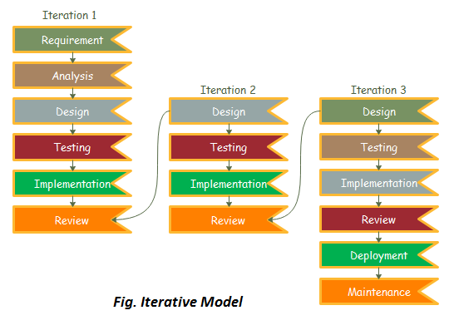
Approach: Iterative Development
Breaks down tasks into manageable sprints.
Executes development iteratively within short time frames.
Holds daily stand-ups and conducts reviews and retrospectives at the end of each sprint.

Slide 11
Techniques:
Responsive Design: Ensures adaptability across devices.
Progressive Enhancement: Layers HTML, CSS, and JavaScript for graceful degradation.
Modular Development: Utilizes reusable components for scalability.
Version Control: Tracks changes and facilitates collaboration.
Testing: Implements automated and manual testing for functionality and usability.

Slide 12
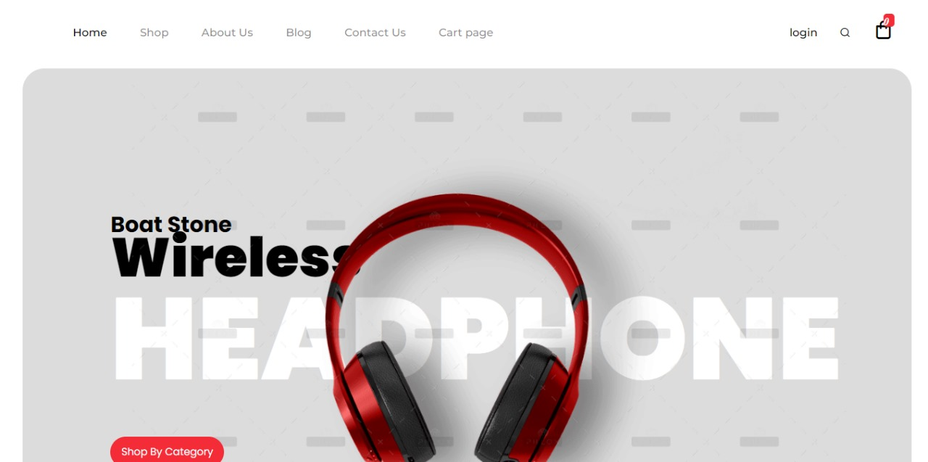
Snapshots

Slide 13
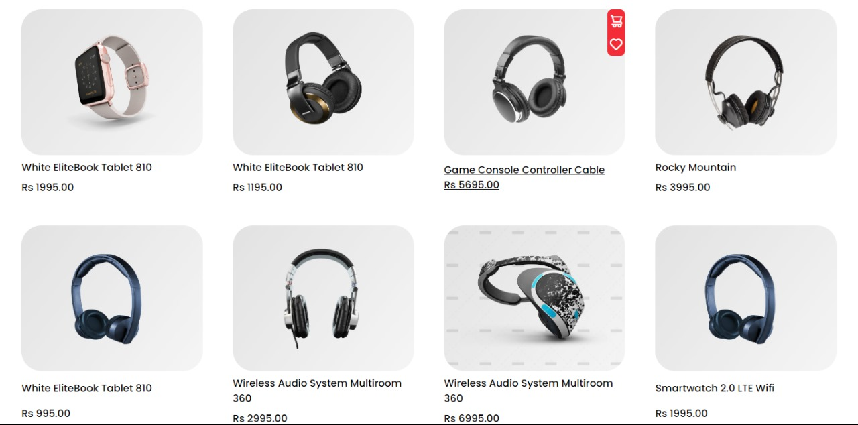
Snapshots

Slide 14
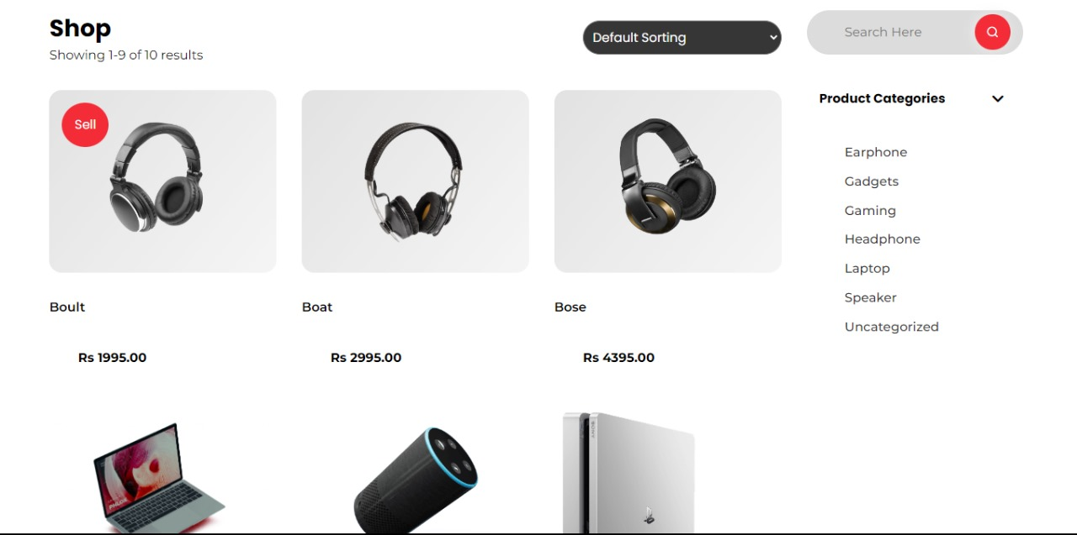
Snapshots

Slide 15
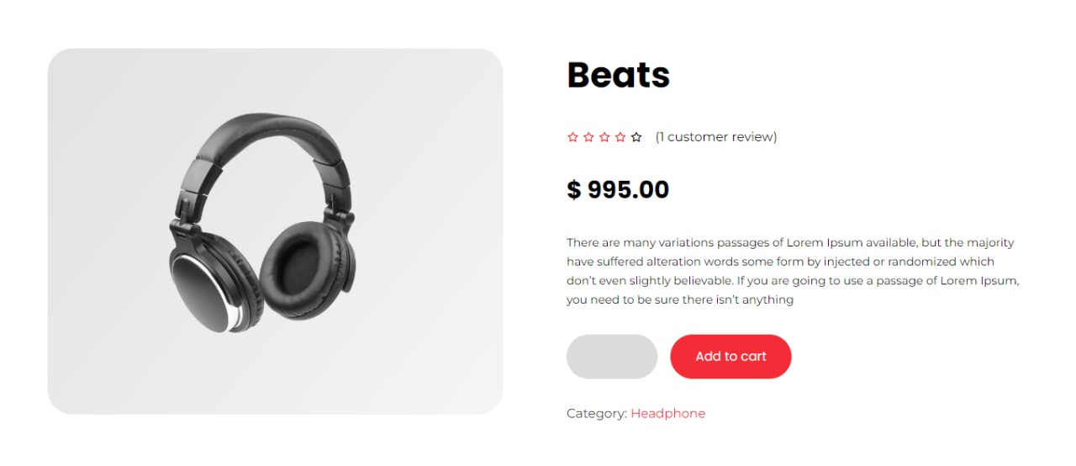
Snapshots

Slide 16
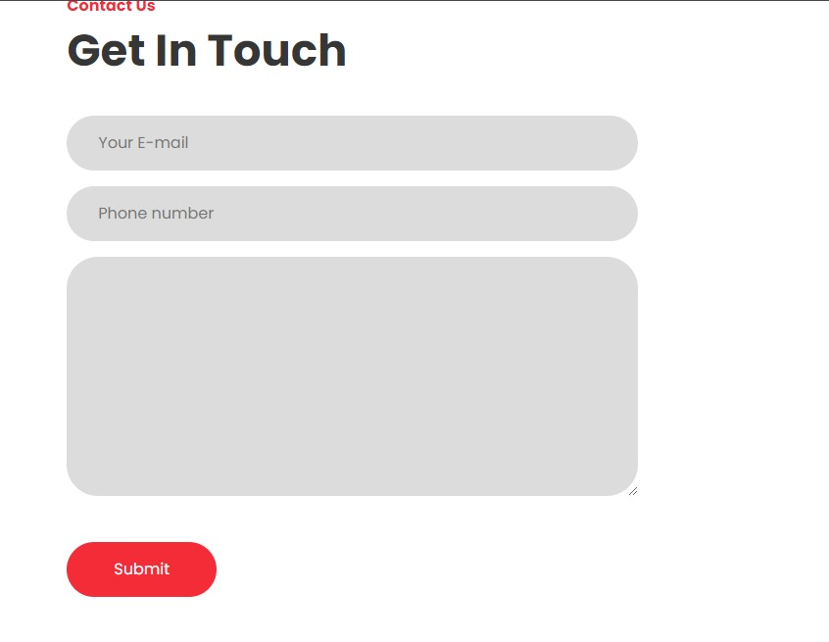
Snapshots

Slide 17
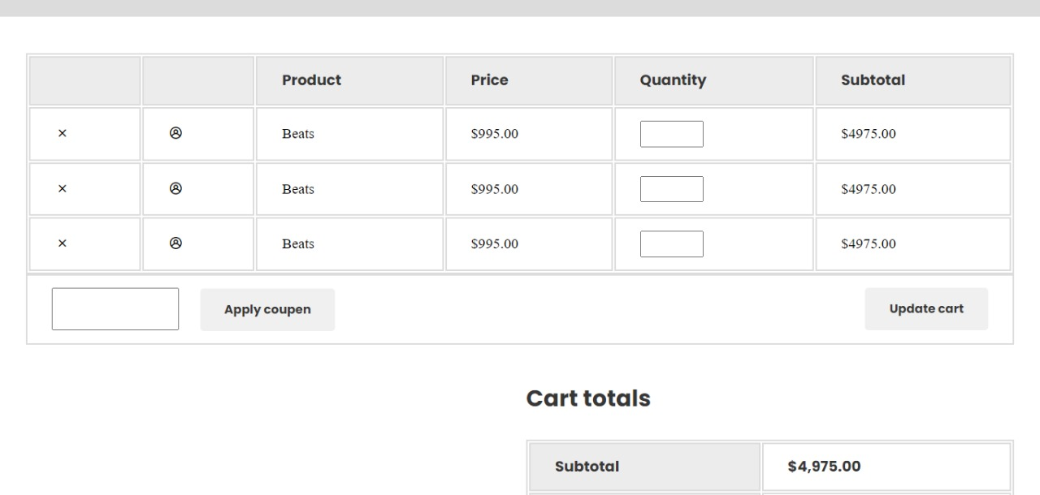
Snapshots

Slide 18
Reference
[1] https://www.w3schools.com/whatis/
[2] https://developer.mozilla.org/en-US/
[3] https://www.phlox.pro/

Slide 19


